Slide 1



















IDEAL MODEL OF PROBLEM SOLVING
BY: RITIK KUMAR
SACHIN RAJBHAR
KARMVIR
SACHIN KR. SINGH
VIKAS
SUBMITTED TO : MR.PUSHKAR NEGI

Slide 2









THE GOAL
WHAT IS PROBLEM-SOLVING?
WHY ARE PROBLEM-SOLVING STRATEGIES IMPORTANT?
IDEAL PROBLEM-SOLVING METHOD
I – IDENTIFY THE PROBLEM.
D – DEFINE AN OUTCOME
A – ANTICIPATE OUTCOMES & ACT
L – LOOK AND LEARN
CONCLUSION

Slide 3
WHAT IS PROBLEM-SOLVING
PROBLEM-SOLVING IS THE CAPACITY TO IDENTIFY AND DESCRIBE A PROBLEM AND GENERATE SOLUTIONS TO FIX IT.

Slide 4
WHY ARE PROBLEM-SOLVING STRATEGIES IMPORTANT?
Problem-solving strategies are important for diverse learners to manage challenging situations effectively
Without a step-by-step model, learners may resort to challenging behaviors when faced with difficult tasks.
The IDEAL Problem-Solving Method is a useful tool for teaching effective problem-solving skills.
Effective problem-solving skills can lead to better academic and social outcomes and create a more positive and supportive learning environment

Slide 5


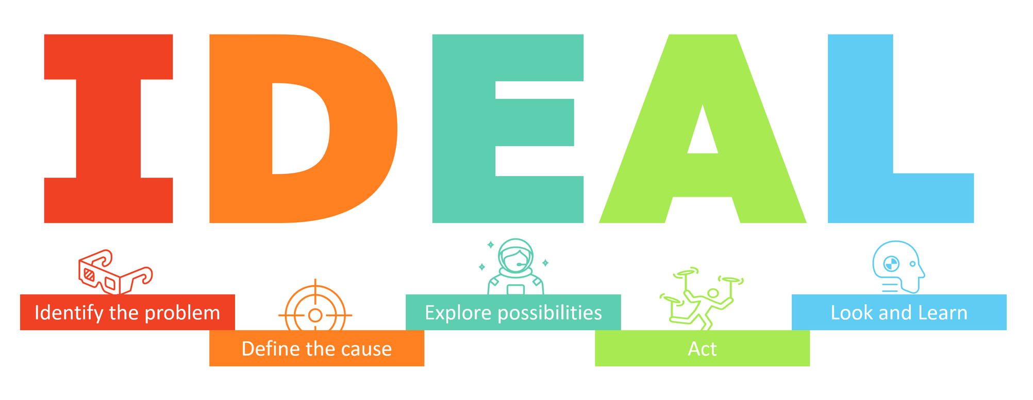



In 1984, Bransford and Stein published one of the most popular and well-regarded problem-solving methods. It’s used both in industry and in education to help various learners establish a problem, generate solutions, and move forward quickly and efficiently.

Slide 6


I – IDENTIFY THE PROBLEM.
There’s no real way to create a solution to a problem unless you first know the scope of the problem.
Encourage your learner to identify the issue in their own words.

Slide 7
I – IDENTIFY THE PROBLEM.
EXAMPLES OF IDENTIFYING PROBLEMS:
“I HAVE A MATH QUIZ NEXT WEEK AND DON’T KNOW HOW TO DO THE PROBLEMS.”
“I CAN’T ACCESS MY DISTANCE LEARNING COURSE WEBSITE.”
“THE TRASH NEEDS TO BE TAKEN OUT, AND I CAN’T FIND ANY TRASH BAGS.”

Slide 8

D – DEFINE AN OUTCOME
The second step in the IDEAL problem-solving process is to define an outcome or goal for problem-solving.
Multiple people can agree that a problem exist but have very different ideas on goals or outcomes
can agree that
By deciding on an outlined objective first, it can speed up the process of identifying solutions.

Slide 9
D – DEFINE AN OUTCOME
EXAMPLES OF DEFINING OUTCOMES:
“I WANT TO DO WELL ON MY MATH QUIZ.”
“I GET ACCESS TO THE COURSE WEBSITE.”
“THE TRASH GETS TAKEN OUT BEFORE THE TRASH PICKUP DAY TOMORROW.”

Slide 10

E – EXPLORE POSSIBLE STRATEGIES.
Once you have an outcome, encourage your learner to brainstorm possible strategies.
All possible solutions should be on the table during this stage, so encourage learners to make lists, use sticky notes, or voice memos to record any ideas.

Slide 11
E – EXPLORE POSSIBLE STRATEGIES.
EXAMPLES OF POSSIBLE STRATEGIES TO SOLVE A PROBLEM:
“I REVIEW THE TEXTBOOK; I ASK FOR MATH HELP FROM A FRIEND; I LOOK UP THE PROBLEMS ONLINE; I EMAIL MY TEACHER.”
“I EMAIL MY TEACHER FOR THE COURSE ACCESS; I ASK FOR HELP FROM A CLASSMATE; I TRY TO RESET MY PASSWORD.”
“I USE SOMETHING ELSE FOR A TRASH BAG; I PLACE AN ONLINE ORDER FOR BAGS; I TAKE THE TRASH OUT WITHOUT A BAG; I ASK A NEIGHBOR FOR A BAG; I GO SHOPPING FOR TRASH BAGS.”

Slide 12

A – ANTICIPATE OUTCOMES & ACT
Decide which one is the best option to use first.
Helping learners to evaluate the pros and cons of action steps can take practice.
Ask questions like, “What might happen if you take this step?”

Slide 13
A – ANTICIPATE OUTCOMES & ACT
ASK QUESTIONS LIKE,
“WHAT MIGHT HAPPEN IF YOU TAKE THIS STEP?”
OR
“DOES THAT STEP MAKE YOU FEEL GOOD ABOUT MOVING FORWARD OR UNCERTAIN?”

Slide 14

L – LOOK AND LEARN
The final step in the IDEAL problem-solving model is to look and learn from an attempt to solve a problem.

Slide 15
L – LOOK AND LEARN
EXAMPLES OF LOOK AND LEARN STATEMENTS:
“I DIDN’T LEARN THE PROBLEMS FROM LOOKING AT THE TEXTBOOK, BUT IT DID HELP TO CALL A FRIEND. I’LL START THERE NEXT TIME.”
“WHEN I DIDN’T HAVE ACCESS TO THE COURSE WEBSITE, RESETTING MY PASSWORD WORKED.”
“I RAN OUT OF TRASH BAGS BECAUSE I FORGOT TO PUT THEM ON THE SHOPPING LIST. I’LL BUY AN EXTRA BOX OF TRASH BAGS TO HAVE THEM ON HAND, SO I DON’T RUN OUT NEXT TIME.”

Slide 16



CONCLUSION
Overall, the ideal model of problem-solving is a systematic and iterative process that involves critical thinking, creativity, and effective communication. It requires a commitment to continuous learning and improvement, as well as an ability to work collaboratively with others.

Slide 17


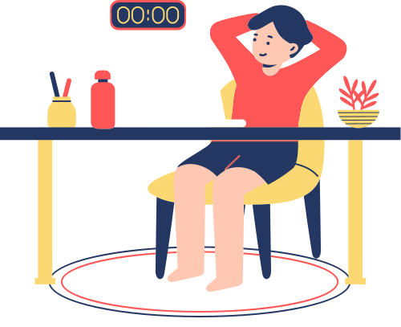
Thank
you
HAVE A GOOD DAY!
ASK ANY QUESTIONS???

